Slide 1
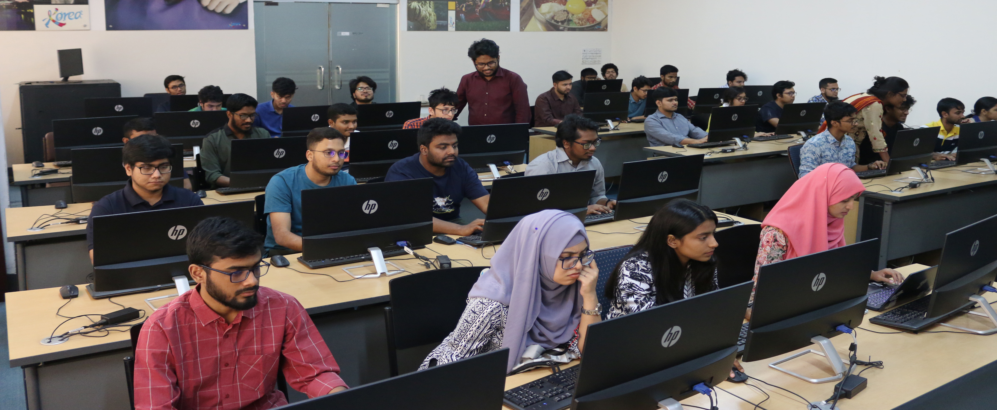
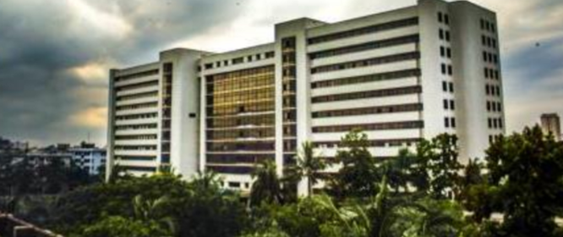
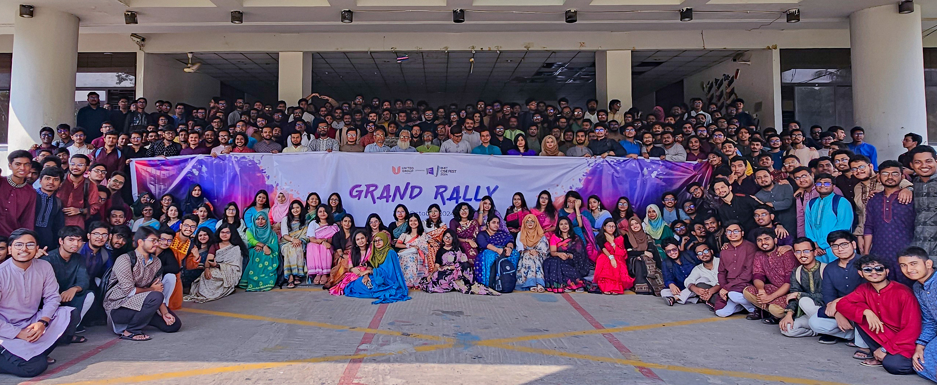


Welcome to the department of CSE, BUET
A pioneering center of excellence at the national and international levels

Slide 2
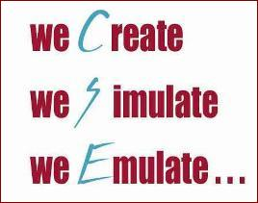

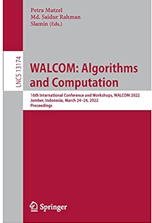

Department of CSE, BUET
The first department of its kind in Bangladesh
  48 faculty members, including 16 professors
Degrees offered
  Ph.D.; M.Sc. Engg.; M. Engg.; M.Sc.; B.Sc. Engg.
International conferences
  WALCOM (Proceedings - LNCS, Springer, 18 years)
  NSysS (Proceedings - ACM ICPS, 12 years)

Slide 3
Department of CSE, BUET
Vision Statement
To enable innovation through research and advancement of educational programs in Computer Science and Engineering (CSE) and allied fields, thereby establishing this department as a pioneering center of excellence at the national and international levels.

Slide 4





















Research in Department of CSE, BUET
Research Areas | Faculty Members | Publications
Artificial Intelligence and Machine Learning | 18 | 55+
Algorithms and Theory | 6 | 120+
Systems and Networking | 24 | 160+
Bioinformatics and Computational Biology | 13 | 150+
Graphics, Visualization and Human Computer Interaction | 5 | 25+
Database, Data mining, Big Data | 10 | 80+
Information Systems & Software Engineering | 6 | 25+
Hardware, Computer Architecture, VLSI, Programming Languages and Compilers | 12 | 20+
Security and Privacy | 9 | 20+
Mobile and Ubiquitous Computing | 4 | 15+

Slide 5
Research in Department of CSE, BUET
Research in highly-reputed journals
  IEEE Transactions on Neural Networks
  IEEE Transactions on Systems, Man, and Cybernetics, Part B (Cybernetics)
  IEEE Transactions on Geoscience and Remote Sensing
  IEEE Transactions on Parallel and Distributed Systems
  IEEE Transactions on Dependable and Secure Computing
  ACM on Interactive, Mobile, Wearable and Ubiquitous Technologies (IMWUT)
  ACM Transactions on Spatial Algorithms and Systems
  ACM/IMS Transactions on Data Science
  Bioinformatics
  Briefings in Bioinformatics
  Transactions on Machine Learning Research
  Expert Systems with Applications
  Nature Scientific Report
  Medical & Biological Engineering & Computing
  Neural Computing & Applications
  Applied Soft Computing
  Journal of Computational Biology
  EPMA Journal
  Ocean Engineering
  Journal of Network and Systems Management

Slide 6
Research in Department of CSE, BUET
Research in highly-reputed conferences
  Association for Computational Linguistics (ACL)
  ACM SIGKDD International Conference on Knowledge Discovery & Data Mining (KDD)
  IEEE International Conference on Data Mining (ICDM)
  Ubiquitous Computing (Ubicomp)
  International Conference on Mobile Data Management
  International Conference on Intelligent User Interfaces
  IEEE International Conference on Communications (ICC)
  Computing, Networking and Communications (WiMob)
  International Symposium on Modeling, Analysis & Simulation of Computer and Telecommunication Systems (MASCOTS)

Slide 7









CSE, BUET Research Collaborations
Notes:
Microsoft Research
IBM Research
University of Melbourne, Australia
Tohoku University, Japan
University of California, San Diego
Carnegie Mellon University
McMaster University, Canada
Monash University, Australia
Marquette University, US
Baylor College of Medicine, USA
University of Louisiana, USA
The pages need to be updated with images
International Exposure
Samsung
Oracle
Cisco
Tiger IT

Slide 8
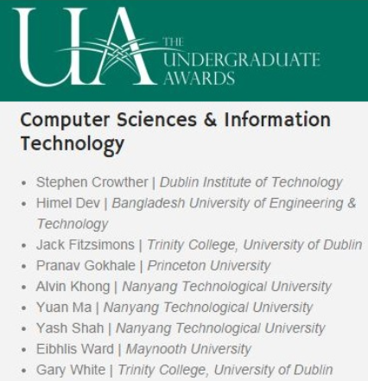

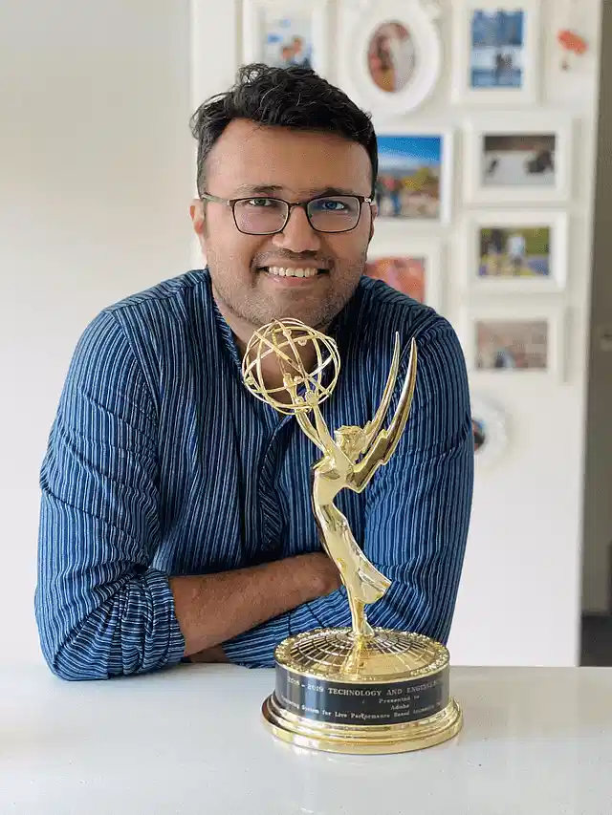
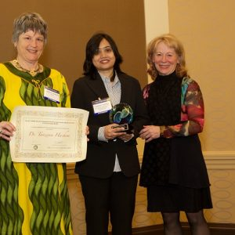

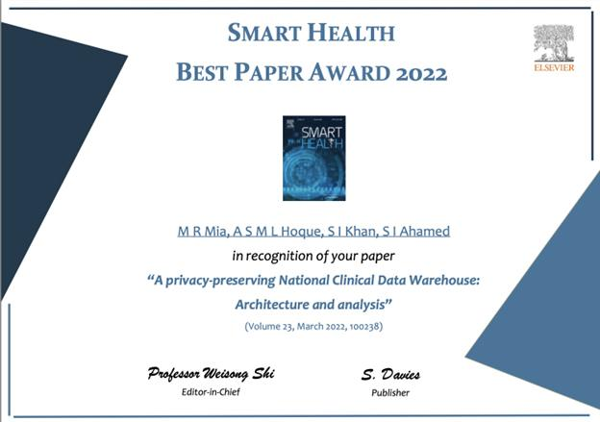
Faculties and Alumni Winning Awards!
Different prestigious Research Grants
Best and Distinguished Papers Awards
BAS Gold Medal
  Senior and Junior Scientist
OWSD-Elsevier Award
Interstellar Initiative Early Career Award (jointly presented by the New York Academy of Sciences and the Japan Agency for Medical Research and Development)
NSF CAREER Award!
Forbes 30 Under 30!
Emmy Awards!
The World Academy of Sciences (TWAS) Gold Medal
  And many more….

Slide 9
Infrastructure at a glance
Classrooms with projector or smart screen, audio systems
Computing Laboratories
Graph drawing and information visualization lab
Graduate Seminar room
Graduate lab with 20 cubicles
Cloud computing lab
Bangladesh Korea Information Access Center (BK-IAC)
We need to invest more on preparing cloud and GPU infrastructure

Slide 10
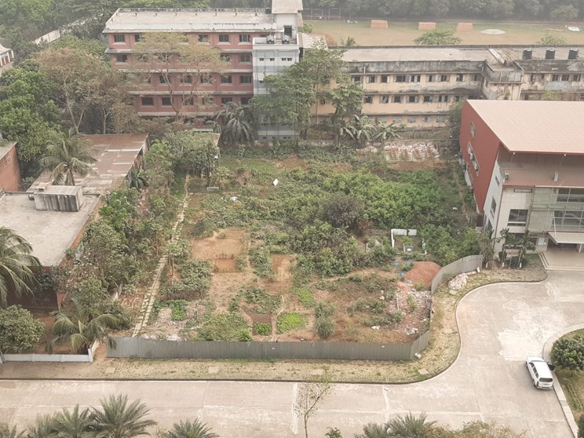
ICSETEP Funded by ADB
Improving Computer and Software Engineering Tertiary Education Project (ICSETEP)
Asian Development Bank (ADB) and Government of Bangladesh (GOB) funded
Cornerstone for developed Bangladesh
Quality and industry-relevant CSE/IT programs
Incubation facility for homegrown startups
Industry-Academia Collaboration
Proposed Location for new building
Notes:
350+ crore BDT project value.

Slide 11
Things you should know
Rules and regulations
  Will be covered by Dr. Atif
Accommodation
  Full-time students are eligible for seats in halls
  Check with Hall Office for further steps
Funding
Notes:
350+ crore BDT project value.

Slide 12
Funding Opportunities (Full-time students)
Fellowship & TAship from BUET (Dr. Atif will cover)
ICT Fellowship (ICT Division)
  https://ims.ictd.gov.bd/
  40,000 BDT per month
  3 years duration
UGC PhD Fellowship
  40,000 BDT per month
  3 years duration
PMEAT PhD Fellowship
  https://www.eservice.pmeat.gov.bd/phd/index.php
  15000 BDT per month
  2 years duration
  Deadline: 11-June-2026
NST Fellowship
PhD Fellowship under ICSETEP RDG subprojects
  Check with your supervisor for availability
Notes:
350+ crore BDT project value.

Slide 13
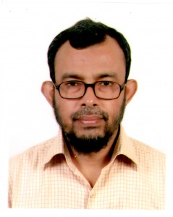
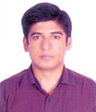
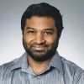
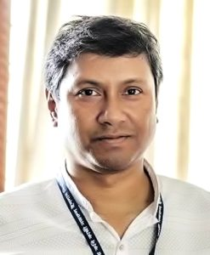
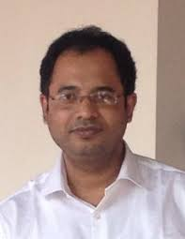
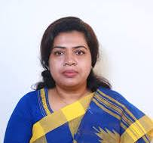
CSE BUET PhD Alumni
Dr. Md. Rezaul Karim (2008)
Professor, CSE, DU
Dr. Mohammad Shafiul Alam (2013)
Professor, CSE, AUST
Supervised by
Dr. Md. Saidur Rahman
Supervised by
Dr. Md. Monirul Islam
Dr. Md. Iqbal Hossain (2015)
Artificial Intelligence Specialist
U.S. Department of the Treasury
Dr. A H M Kamal (2017)
Professor, CSE &
Dean, Faculty of Science & Engg.
JKKNIU
Supervised by
Dr. Md. Saidur Rahman
Supervised by
Dr. Mohammad Mahfuzul Islam
Dr. Md. Saddam Hossain Mukta (2018)
Post-doctoral Researcher
LUT University, Finland
Dr. Shaheena Sultana (2018)
Professor, Dept. of CSE, NDUB
Women IT Leadership Program Specialist, ICSETEP
Supervised by
Dr. Dr. Mohammed Eunus Ali
Supervised by
Dr. Md. Saidur Rahman
Notes:
Jkkniu -- JATIYA KABI KAZI NAZRUL ISLAM UNIVERSITY

Slide 14
CSE BUET PhD Alumni
Alumni | Pass.Year | Supervisor | Current Affiliation
Shahidul Islam Khan | 2020 | Dr. Abu Sayed Md. Latiful Hoque | Professor and Head, CSE Presidency University
Md. Zahangir Alam | 2021 | Dr. M. Sohel Rahman | Software Engineer (AI/ML), Tasacom Technologies Inc., USA
Muhammad Ali Nayeem | 2022 | Dr. M. Sohel Rahman | Assistant Professor, Computer Engineering, Qassim University, Saudi Arabia
Jannatun Noor Mukta | 2023 | Dr. A.B.M. Alim Al Islam | Associate Professor, CSE & Director, Data Science Program, UIU
Md. Manzurul Hasan | 2023 | Dr. Md. Saidur Rahman | Associate Professor, CS, AIUB
Md. Ruhul Amin | 2024 | Dr. Md. Shohrab Hossain | Associate Professor, CSE, Southeast University
Joydeb Kumar Sana | 2025 | Dr. Mohammad Saifur Rahman | Senior System Analyst, IICT, BUET
Notes:
Jkkniu -- JATIYA KABI KAZI NAZRUL ISLAM UNIVERSITY

Slide 15
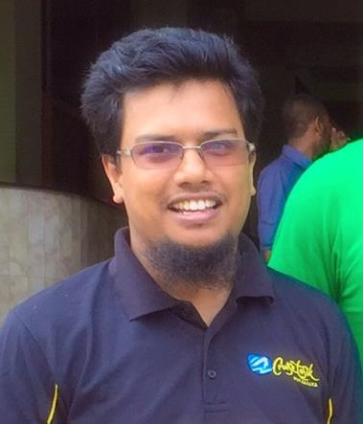
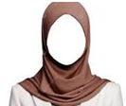
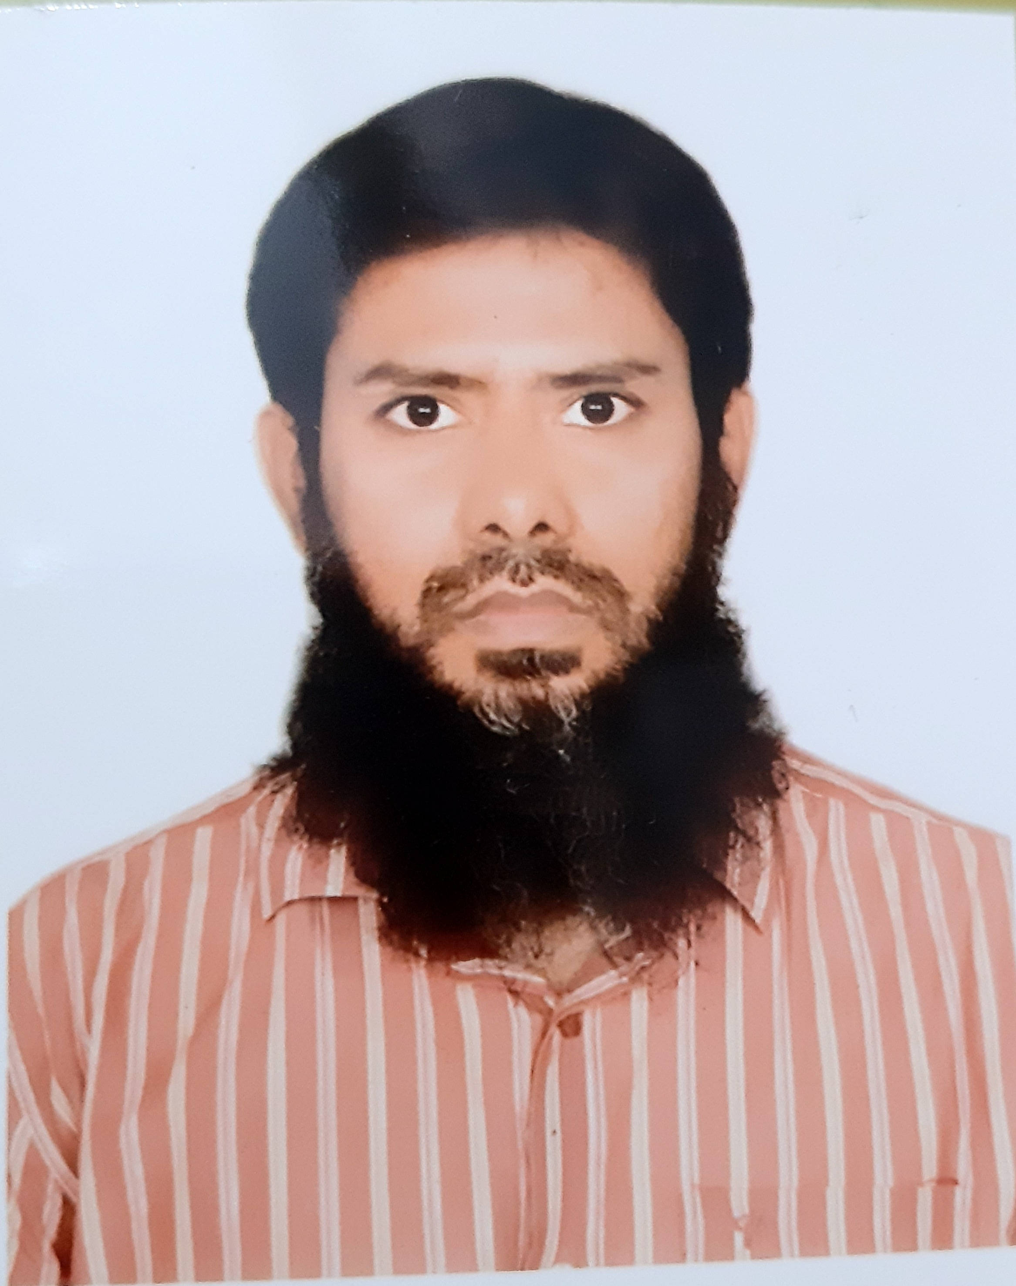
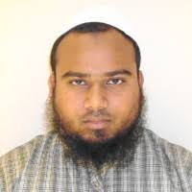
CSE BUET (PhD Alumni + Faculty Member)
Dr. M Saifur Rahman (2018)
Professor, CSE, BUET
Dr. Novia Nurain (2019)
Assistant Professor, CSE, BUET
Supervised by
Dr. M Kaykobad
Supervised by
Dr. A.B.M. Alim Al Islam
Dr. Tanveer Awal (2023)
Assistant Professor, CSE, BUET
Dr. Md. Shariful Islam Bhuyan (2026)
Associate Professor, CSE, BUET
Supervised by
Dr. A.B.M. Alim Al Islam
Supervised by
Dr. Mohammad Saifur Rahman
Notes:
Jkkniu -- JATIYA KABI KAZI NAZRUL ISLAM UNIVERSITY

Slide 16
CSE BUET (PhD Alumni + Faculty Member)
Dr. M Saifur Rahman (2018)
Professor, CSE, BUET
Dr. Novia Nurain (2019)
Assistant Professor, CSE, BUET
Supervised by
Dr. M Kaykobad
Supervised by
Dr. A.B.M. Alim Al Islam
Dr. Tanveer Awal (2023)
Assistant Professor, CSE, BUET
Dr. Md. Shariful Islam Bhuyan (2026)
Associate Professor, CSE, BUET
Supervised by
Dr. A.B.M. Alim Al Islam
Supervised by
Dr. Mohammad Saifur Rahman
Feel free to reach out to us for any discussions along your journey.
Notes:
Jkkniu -- JATIYA KABI KAZI NAZRUL ISLAM UNIVERSITY

Slide 17
Thank You!

